Slide 1
Notes:
Laetitia

Slide 2
Notes:
Laetitia

Slide 3
Together, we will help make Canadians #unbreakable.
Notes:
Laetitia

Slide 4
Notes:
Laetitia

Slide 5
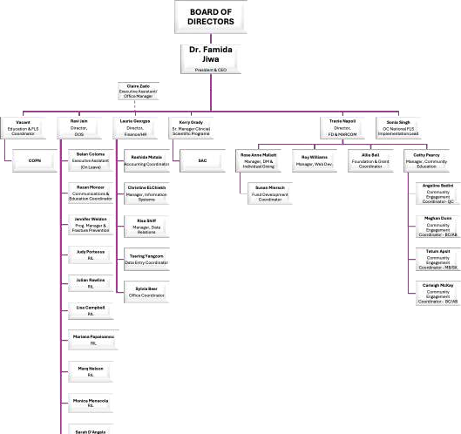
Notes:
Famida

Slide 6
Notes:
Famida

Slide 7
Notes:
Famida

Slide 8
Notes:
Famida

Slide 9
Notes:
Famida

Slide 10
Notes:
Famida

Slide 11
Welcome to OC’s Scientific
Advisory Council
Notes:
Laetitia
Welcome new members: Dr Andrea Cowan, Dr. Michele Monroy-Valle, Dr. Noemie Theriault,
Dr. Shirine Usmani, Sarah Rydahl, Dr. Sophie Roux, Dr. Wasim Mansoor

Slide 12
SAC Overview
Review of Terms of Reference
SAC Individual
SAC Committee Member
Review of COI
OC Staff Support
Notes:
Laetitia

Slide 13
Responsibilities
Provide assistance, support, advice and guidance to the Executive Committee of the SAC and Osteoporosis Canada on technical, scientific or medical matters.
Review and validate material prepared for public or professional distribution with respect to
scientific/medical content.
When required, actively participate on committees based on availability and expertise
Respond in a timely manner to requests
Lend their names and prestige to further the purposes and goals of the Organization.
Speak on behalf of OC and/or to represent OC as requested by the Chair of the SAC and/or
President & CEO.
Be regional agents, at the request of the Chair of the SAC and/or Board
Represent, where appropriate, OC internationally.
Promote and foster the growth of OC, where appropriate.
Safeguard and protect the credibility of OC by being consistent with OC messages when acting in the capacity of an SAC consultant.
Maintain membership, in good standing, of OC
Honour financial obligation to OC as an annual donor.
Provide signed Confidential Disclosure Statement annually.
Notes:
Laetitia
Ask them to refer to the Terms of reference that is sent out annually with the Conflict of Interest form

Slide 14
Conflict of Interest
Notes:
Laetitia
Just a reminder they will be asked to complete a COI form annually

Slide 15
SAC Committees
Notes:
Laetitia

Slide 16
SAC Committees
Executive Committee
Chair: Laetitia Michou
Vice Chair: Adrian Lau
Past Chair: Rowena Ridout
Members: Sid Feldman, Aliya Khan, Adrian Lau, Lianne Tile, Natasha Gakhal, Lora Giangregorio, Linda Probyn, Ahmed Negm, Claudia Gagnon, Sandra Kim
Shall assume active leadership, in collaboration with SAC consultants, SAC committees where appropriate, the National Board, and the President and CEO (or designated National Office Staff), in its primary role as advisor and guide to OC’s President/CEO on all technical, scientific and/or medical matters.
Strategic plannin_{T}g_{og}an_{e}d_{th}o_{e}v_{r}e,rs_{w}e_{e}ein_{w}g_{il}t_{l}h_{h}e _{e}w_{l}o_{p}rk_{m}o_{a}f _{k}th_{e}e _{C}co_{a}m_{n}m_{ad}it_{i}te_{a}e_{n}s_{s}th#a_{u}t_{n}d_{b}ire_{re}ct_{a}t_{k}h_{a}e_{ble.}
activities of the SAC
Notes:
:aetitia

Slide 17
Guidelines Committee
Chair: Dr. Sandra Kim
Members: Carrie Ye, Emma Billington, Julie Gilmour, Laetitia Michou, Laura Rothman, Leo Lai, Phil Chilibeck, Sabrina Gill, Teri Charrois, Zahra Bardai
The Guidelines Committee of the Scientific Advisory Council (SAC) shall assume active leadership, in collaboration with the Executive Committee of the SAC, in its primary role as scientific reviewer and advisor and guide to OC on all technical, scientific and/or medical matters.
Review and endorsement of scientific material, position statements
Supporting the guidelines Update Steering Committee by developing a formal process for COI management, stakeholder engagement, and eternal peer review with the Clinical Practice Guidelines Update
Notes:
Refer to Sandra

Slide 18
Research Committee
Chair: Ahmed Negm
Members: Alexander Bilbilly, Caitlin McArthur, Fabrice Mac-Way, Jackie Herman (COPN), JD Brown (Student), Joanna Sale, Kristin Clemens, Alex Papaioannou, Suzanne Morin, Lindsay Blencowe, Laetitia Michou
Shall assume primary responsibility for identifying, recommending and funding research opportunities
Recommends recipient candidates for the Research and Travel Awards
offered by Osteoporosis Canada
Notes:
Refer to Ahmed

Slide 19
Development Committee
Chair: Lianne Tile
Members:Angela Cheung, Heather Frame, Heather McDonald-Blumer, Laetitia Michou, Larry Dian, Wendy Ward, Sandra Kim
shall assume primary responsibility for ongoing cultivation, recruitment and selection of appropriately qualified candidates for the Scientific Advisory Council, its Executive Committee, Guidelines Committee, and Research Committee
Notes:
Refer to Lianne

Slide 20
KT Core Committee
Co-Chairs: Aliya Khan and Natasha Gakhal
Members: Adrian Lau, Miranda Boggild,. Julie Gilmour, Larry Funnell
(COPN), Monica Menecola, Tim Cuddy, Lianne Tile, Laetitia Michou
GP Subcommittee: Chair: Miranda Boggild /Natasha Gakhal
DI Subcommittee: Chair: Aliya Khan
•
Indigenous Subcommittee: Chair: Aliya Khan
Ortho Subcommittee: Chair: Natasha Gakhal
To identify strategies for knowledge translation of OC guidelines and best
practices.
To identify subcommittees based on the target groups
To provide direction to the subcommittees and oversee their progress
Notes:
Refer to Aliya and Natasha

Slide 21
COPN Review Committee
Chair: Adrian Lau
Members: Joanna Sale, Teri Charrois, Zahra Bardai , Laura Rothman, Jennifer Thain
Provides scientific and educational guidance for COPN : Canadian Osteoporosis Patient Network
Notes:
Refer to Adrian

Slide 22
Notes:
Refer to Adrian

Slide 23
Rapid Response Team
Chair: Adrian Lau
Members: Laetitia Michou, Allan Low, Claudia Gagnon, Emma Billington, Zahra Bardai, Vithika Sivabalasundaram
Responsible for responding to breaking news releases in the media that may impact perspective on osteoporosis/bone health care through a rapid response position statement in order to guide health professionals and the public
Notes:
Refer to Adrian

Slide 24
OC Activities
Osteoporosis Guidelines
Beyond the Break
Bone Matters
Bone Fit
Canadian Musculoskeletal Conference (CMC) 2026
SAC Link
OC Website
Annual SAC Breakfast at ASBMR
Notes:
Laetitia

Slide 25
How Can You Get Involved?
Kerry Grady KGrady@osteoporosis.ca
Notes:
Laetitia

Slide 26
Questions?
Notes:
Laetitia

Slide 27
Notes:
Laetitia

